Slide 1
The effects of intermittent compared with continuous energy restriction on glycaemic control in type 2 diabetes.
Sharayah Carter¹, Peter Clifton¹, Jennifer Keogh¹
¹ School of Pharmacy and Medical Sciences, University of South Australia
Presenter : Assistant Professor Yoona Kim²
² Department of Food and Nutrition, Gyeongsang National University

Slide 2
Disclosures
Peter Clifton
‘No conflicts of interest’

Slide 3
Background
Intermittent energy restriction is an alternative weight loss method defined as short periods of severe energy restriction interspersed with normal energy intake.
It has been suggested that because this method offers a reduced burden of dietary restriction and shows promise in achieving weight
loss goals, it may be a useful alternative to standard continuous
weight loss diets [Johnstone 2015; Seimon 2015; Varady 2011].

Slide 4
Background
Reviews of the literature comparing continuous with intermittent energy restriction have demonstrated similar weight loss in both groups, often attributed to the similar weekly energy restriction.
[Johnstone 2015; Seimon 2015; Varady 2011, Headland 2016, Davis 2016; Harvie 2017; Patterson 2015].
However, there have been few studies to date investigating the effects
of intermittent compared to continuous energy restriction
in people with type 2 diabetes [Carter 2016; Carter 2018; Corley 2018; Arnason 2017; Ash 2003] and the available long-term maintenance data is limited [Ash 2003].

Slide 5
Aims: We investigated the long-term effects of intermittent compared to continuous energy restriction diet on glycaemic control in patients with T2DM.
Hypothesis: we hypothesized that equal improvements to HbA1c level and weight would occur, as seen in our 3-month pilot trial, thus offering a successful alternative treatment strategy for use in clinical practice.
Similar weekly energy restriction therefore similar improvements to weight and glycaemic control.
Diet | Energy Restriction | Weekly Energy
Continuous | ~30% ER daily | 44MJ/week*
Intermittent | ~75% ER 2/week | 48MJ/week*
*Based on 2500kJ IER vs. 6300kJ CER energy restriction plans

Slide 6
Inclusion Criteria
Adults >18 years
BMI >27kg/m2
T2DM (Diet Control, sulphonylureas or Insulin)
Not pregnant or breast feeding
Exclusion Criteria
No history of weight loss surgery or weight loss >5 kg in past 3 months
Blood Pressure (>160/100 mmHg)
Women who are pregnant or breast feeding or wish to become pregnant
Serious illness not otherwise managed (e.g. cancer, liver or renal disease)
Drinking > 2 standard alcoholic drinks per day and not able/willing to decrease

Slide 7
Medication Management Protocol
Due to the risk of hypoglycaemia a medication management plan was developed in consultation with an endocrinologist (P.M.C).
Only medications likely to cause hypoglycaemia were altered at baseline-sulphonylureas and insulin.

Slide 8
Medication Management
All participants was asked to test and record their fasting blood glucose levels daily,
i.e. before breakfast, with the addition of 2 extra readings requested on intermittent diet days, which must include a before bed reading.
< 4 mmol/L participants was asked to contact study investigators via phone or email for medication changes.
> 10 mmol/L dietary compliance was checked at clinic visit and if necessary medication changes were made.

Slide 9
Initial Medication Protocol
HbA1c | OHA (Sulphonylureas) | Insulin
< 8% | Discontinue at baseline for both groups | IER: Halve insulin dose on IER days CER: Reduce by ~10 units/day on CER days * Added during pilot trial: If insulin doses before bed were considered to be too high in preparation for an intermittent diet day, before bed doses were also decreased.
> 8% | Remain unchanged | Reduce by ~10 units on IER days only
IER, intermittent energy restriction; CER, continuous energy restriction

Slide 10
Modified Medication Protocol
Primarily owing to hypoglycemia, after the 38th participant commenced the trial, the
new protocol required the discontinuation of sulfonylureas and insulin for all participants.
HbA1c | OHA (Sulphonylureas) | Insulin
< 7% | Discontinue at baseline for both groups | Discontinue at baseline for both groups
> 7-10% | Discontinue on IER days only | -IER: Discontinued on IER days only and long-acting insulin discontinued the night before IER day. Insulin was resumed until a full day’s caloric intake was planned (if taken in the morning) or achieved (if taken in the evening). -CER: Reduce by ~10 units/day on CER days depending on dose.
> 10% | Remain unchanged | Reduce by ~10 units/day on IER days only
IER, intermittent energy restriction; CER, continuous energy restriction
Notes:
primarily owing to hypoglycemia, after the 38th participant commenced the trial. The new protocol required the
discontinuation of sulfonylureas and insulin for all participants
if the baseline HbA1c level was less than 7%(to convert to proportion of total hemoglobin, multiply by 0.01).
If the HbA1c level was higher than 7%but less than 10%, then sulfonylureas and insulin were discontinued on intermittent
energy restriction days only, and long-acting insulin was discontinued the night before an
intermittent energy restriction day. Medications could be reduced in the continuous energy
restriction diet group depending on dose, at the endocrinologist’s discretion.
If the HbA1c level was
higher than 10%, sulfonylurea medications remained unchanged, but long-acting insulin was
decreased by approximately 10 units on intermittent energy restriction diet days only. Although most
participants followed the protocol, the endocrinologist worked with each participant individually to
ensure the best care. In some cases, participants chose not to follow the protocol or preferred to
work with their own medical practitioner for medication adjustment

Slide 11
Glycaemic Events - <4 or >10 mmol/L
35% of participants (16 of 46) using relevant medications experienced unwanted glycaemic events after the first 2 weeks of treatment with no difference between groups.
17% hypos: 2.0 [1.0] events CER vs. 2.5 [0.8] events IER (p=0.74)
22% hypers: 4.0 [0.6] events CER vs. 5.6 [2.0] events IER (p=0.47)
Hypos at all levels of HbA1c -more in >8.5% group
23/46 had med changes; in this group 8 hypers, 3 hypos

Slide 12
Methods : RCT Dietary Intervention
vs.
DAILY DIET
Participants were randomised 1:1 to treatment groups, stratified by sex and BMI.
Participants randomised to the intermittent energy restriction group followed a diet of 2100 to 2500 kJ/day (500–600 kcal/day) for 2 days of the week and followed their usual diet for the other 5 days.
Participants in the continuous energy restriction group followed a diet of 5000 to 6300 kJ/day (1200–1500 kcal/day) (45% carbohydrate, 30% protein and 25% fat)’
Compare the long-term effects:
Intermittent restriction (2100-2500kJ) for 2d/wk + usual diet 5d/wk (5:2).
Continuous restriction (5000-6300kJ) everyday (Daily Diet).

Slide 13
Methods : RCT Dietary Intervention
vs.
DAILY DIET
Both groups received written dietary information booklets with portion advice and sample menus; no food or meal replacements were provided.
Dietary counselling was provided by a dietitian (S.C.) and occurred every 2 weeks for the first 3 months and every 2 to 3 months for the final 9 months.
After the end of this 12-month trial, participants were followed-up again 12 months later (24 months after baseline) for measurement of HbA1c, body composition and fasting blood samples.
.
Notes:
participants were randomised 1:1 to treatment groups,
stratified by sex and bodymass index (as obese or non-obese).
Participants randomised to the intermittent energy restriction
group followed a diet of 2100 to 2500 kJ/day (500–600 kcal/day)
for 2 days of theweek and followedtheir usual diet for the other
5 days. Participants in the continuous energy restriction group
followed a diet of 5000 to 6300 kJ/day (1200–1500 kcal/day) (45%
carbohydrate, 30% protein and 25% fat) [15].

Slide 14
vs.
RCT Dietary Intervention
DAILY DIET
Serve advice for each food group + sample meal plans (no meal replacements).
BGLs tested daily + 2 extra readings on IER days.
Dietary counselling every 2 weeks for 3 months, then every 2 months for the final 9 months.
Compliance monitored via diet checklists, weight loss and BGL improvement/control.
Intermittent restriction: 2100-2500kJ on 2 non-consecutive d/wk + usual diet 5d/wk (sensible eating encouraged e.g. ~8700kJ).
Continuous restriction: 5000-6300kJ everyday.

Slide 15
vs.
Diet Interventions – Food Profiles
DAILY DIET
IER 2100-2500 kJ (500-600 kcal/day) | CER 5000-6300 kJ (1200-1500 kcal/day)
1 serve of fruit (150 g) | 300 g fruit
200 g diet yoghurt | 250 mls (375 mls*) reduced fat milk + 200 g diet yoghurt or 40 g of reduced fat cheese
1 slice of whole meal bread* | 2 slices of wholemeal bread + serve of cereal
~150 g cooked lean meat/chicken fish | ~200 g (300g*) cooked lean meat/chicken fish
1 cup of salad + 1.5 cups of cooked vegetables | 1 cup salad + 2 cups cooked vegetables
5 g (1 tsp) margarine/oil (e.g. monounsatured) | 10 g (2 tsp) margarine/oil (e.g. monounsatured)
Diet or low calorie products were allowed. * 2500kJ (600kcal) or 6300kJ (1500kcal/day) meal plan

Slide 16
Outcome Measurements:
All outcome measures were taken at baseline, 3 months, 12 months and 24 months.
The primary outcome was change in HbA1c level.
The secondary outcome was change in body weight (DEXA).
Exploratory outcomes included daily step count; participants were contacted one week before their follow-up appointment and asked to monitor steps using a waist band pedometer.
Medication effect score (MES) was used to quantify medication changes. The MES is calculated as actual drug dose/maximum drug dose X drug mean adjustment factor.
vs.
DAILY DIET

Slide 17
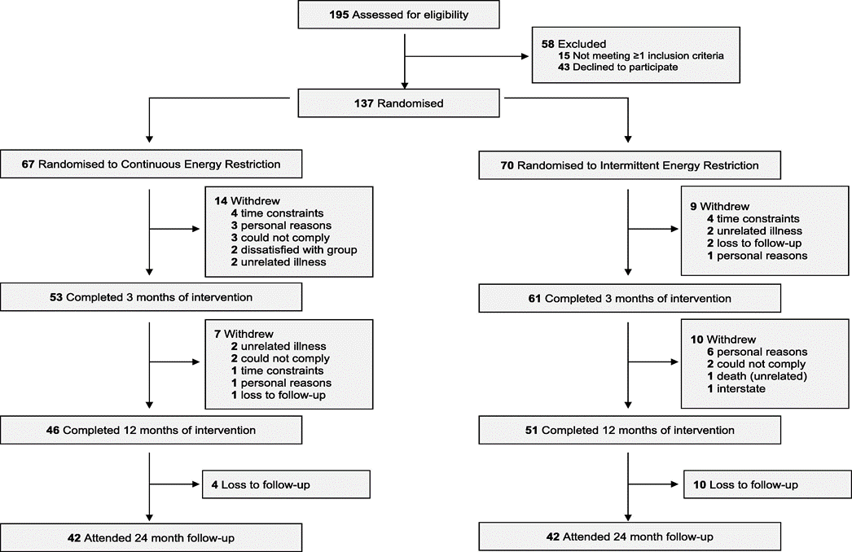
Flow Diagram

Slide 18
Baseline Characteristics
 | Continuous (n=67) | Intermittent (n=70)
Age, y | 61 ± 9.2 | 61 ± 9.0
Gender, Male/Female, No. | 29/38 | 31/39
Duration of diabetes, y | 8.1 ± 6.5 | 7.9 ± 5.9
HbA1c, % | 7.5 ± 1.4 | 7.2 ± 1.2
Weight, kg | 102 ± 17 | 100 ± 19
BMI | 37 ± 5.7 | 35 ± 5.8
Diet Control, No. (%) | 20 (30) | 18 (26)
Oral Glycaemic Agents, No. (%) | 39 (58) | 43 (61)
Insulin, No. (%) | 14 (21) | 12 (20)
Oral Glycaemic Agents MES | 1.4 (0.8) | 1.3 (0.8)
Insulin MES | 1.5 (1.1) | 1.8 (1.1)
Data presented as mean ± SD
Notes:
Mean age 61
Mean BMI 36
Mean HbA1c 7.3%

Slide 19
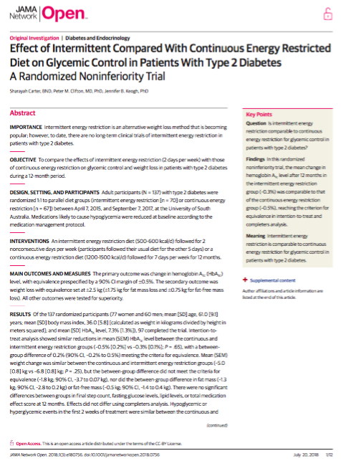
Results
Diets Achieved Similar Results
12 month outcome results
blood glucose control
anthropometry
medication changes (exp. insulin)
CVD risk (lipid profiles)
exercise
appetite

Slide 20
Glycemic Control: HbA1c
Overall reduction: -0.4%
CER -0.5 ± 0.2% vs. IER -0.3 ± 0.1% (p=0.65)
Data presented as mean ± SEM
From baseline to 12 months, the mean (SEM) HbA1c level was reduced significantly, with no difference between treatment groups (–0.5% [0.2%] in the CER group vs. –0.3% [0.1%] in the IER group; P = 0.65), and the results did not differ using completers analysis.
Notes:
The slightly greater change in A1c in the CER group may be explained by the slightly higher A1c at baseline

Slide 21
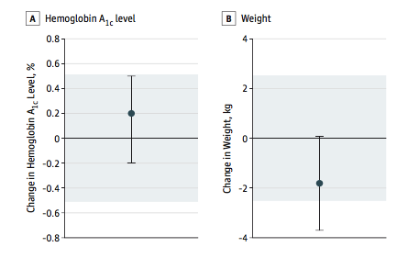
HbA1c change was equivalent
Pre-specified equivalence set at ± 0.5% HbA1c.
The difference in change between both groups fit within the pre-specified bounds.
HbA1c change was equivalent.
Error bars indicate 2-sided 90% CI. Tinted area indicates zone of equivalence.
The mean difference between group in the change in HbA1c level was 0.2%(90% CI, –0.2%to 0.5%) and was contained within the equivalence margin of ±0.5%, confirming equivalence.
Notes:
0.5% change is considered to be a significant clinical change and is half the expected change achieved by most hypoglycemic drugs.

Slide 22
Weight Loss
Overall reduction: -5.9kg (5.8%)
CER -5.0 ± 0.8kg vs IER -6.8 ± 0.8kg (p=0.25)
-4.9%
-6.8%
Weight Loss Compliance
3 months: 90% CER, 97% IER
12 months: 49% CER, 44% IER
Data presented as mean ± SEM
Mean (SEM) weight change was similar between the CER and IER groups (–5.0 [0.8] kg vs –6.8 [0.8] kg; P = 0.25).

Slide 23
Body Composition (DEXA)
P=0.20
P=0.11
CER 32% vs. IER 31% of weight lost
Data presented as mean ± SEM

Slide 24
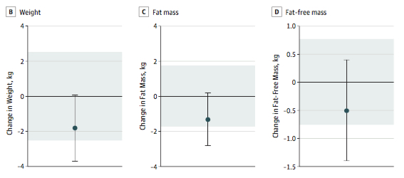
Weight loss did not meet criteria for equivalence
Pre-specified equivalence was set at ± 2.5 kg for weight loss (± 1.75 kg FM, ± 0.75 kg FFM)
IER may be superior for weight loss.
Error bars indicate 2-sided 90% CI. Tinted area indicates zone of equivalence.
However, the between-group difference did not meet the criteria for equivalence (–1.8 kg; 90% CI, –3.7 to 0.07 kg), nor did the between-group difference in fat mass (–1.3 kg;90%CI, –2.8 to 0.2 kg) or fat-free mass (–0.5 kg;90%CI, –1.4 to 0.4 kg).
Notes:
70% FM vs. 30% FFM mass loss was set as acceptable.

Slide 25
Weight Loss: n=42 continued to comply
CER -8.4 ± 1.2 kg vs. IER -12.5 ± 1.8 kg (p=0.07)
Data presented as mean ± SEM
Maintained lower HbA1c (0.6% [0.2%]; p<0.001) with no difference by treatment.
A small subgroup of participants (n=21 in each group) continued to lose weight during the 12 months of the study (mean [SEM] weight reduction was –8.4 [1.2] kg in the CER group and –12.5 [1.8] kg in the IER group; P = 0.07), and these participants maintained the lower HbA1c level seen at 3 to 12 months (mean [SEM] level, 0.6% [0.2%]; P < 0.001) with no difference by treatment.

Slide 26
Lipid Profiles from Baseline to 12-months for IER group vs. CER group
P=0.2
P=0.4
P=0.5
P=0.1

Slide 27
Fasting Plasma Glucose from Baseline to 12-months for IER group vs. CER group
P=0.5
Data presented as mean ± SEM

Slide 28
Steps
P=0.009*
P=0.52
P=0.10
There were no significant differences between groups in final step count at 12 months.
Notes:
Change in steps at 3 mths only accounted for 9% of the weight change.

Slide 29
24 month follow up
Intention-to-treat analysis showed an increase in mean HbA1c level at 24 months in both the continuous and intermittent groups (0.4% [0.3%] vs. 0.1% [0.2%] respectively; P = 0.32) with a between-group difference of 0.3% (90% CI, -0.31 to 0.83%) outside the prespecified boundary of ± 0.5% (5.5 mmol/mol), so statistical equivalence was not shown.
Weight loss was significantly maintained (P < 0.001) at -3.9 kg [1.1 kg] in both groups at 24 months, with a between-group difference of 0.07 kg (90% CI, -2.5 to 2.6 kg) outside the prespecified boundary of ± 2.5 kg.
There were no significant differences between groups in body composition, fasting glucose levels, lipid levels, or total medication effect score at 24 months, which remained less than baseline.

Slide 30
Conclusion
A 2-day intermittent diet is an effective alternative diet strategy for the reduction of HbA1c level comparable to continuous energy restriction in patients with type 2 diabetes, and it may be superior for weight reduction.
It is acceptable for most patients with type 2 diabetes, and safety can be ensured for patients who are not using glycaemic agents likely to cause hypoglycaemia.
For patients using sulphonylureas and/or insulin, regular monitoring is paramount.

Slide 31
Conclusions
Further modification of medication protocol by assessing number of hypos and hypers by CGMS for 2 weeks prior to starting weight loss.
HbA1c not a good indicator of propensity to have hypos.
Current trial comparing fixed medication protocol to one modified by CGMS-detection of hypos prompts more dramatic reduction.
Preliminary results significantly fewer hypos in adjusted group.

Slide 32
Acknowledgments
PhD
Sharayah Carter
Co-supervisor
Associate Professor Jennifer Keogh
Research Team
Michelle Headland
Katja Morsky
Eva Pedersen
Kirsty Turner
Yoona Kim (Previous team member)
Special thanks:
Research volunteers
Sansom Institute for Health Research
Louise Massie
The University of South Australia

Slide 33
Thank you.
Any questions?

